Slide 1
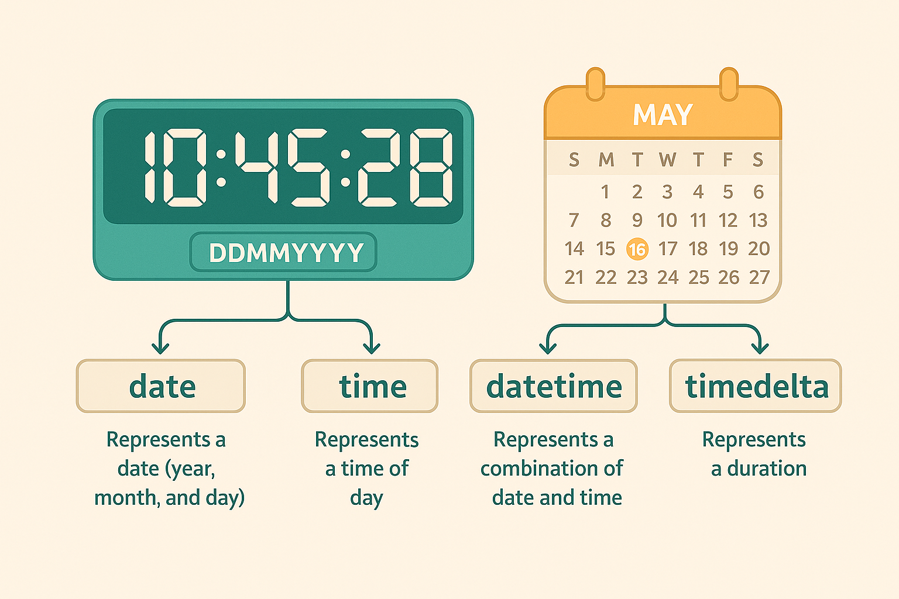
The Dimension of Time
Definition: A sequence of data points indexed in successive order, usually with a fixed frequency (daily, monthly, yearly).
The Temporal Engine: In Python, we move from standard indices to DatetimeIndex, which allows us to treat time as a first-class mathematical object.
Context: Analyzing rainfall in Swat or price fluctuations in Karkhano Market requires looking at trends over years, not just isolated points.

Slide 2
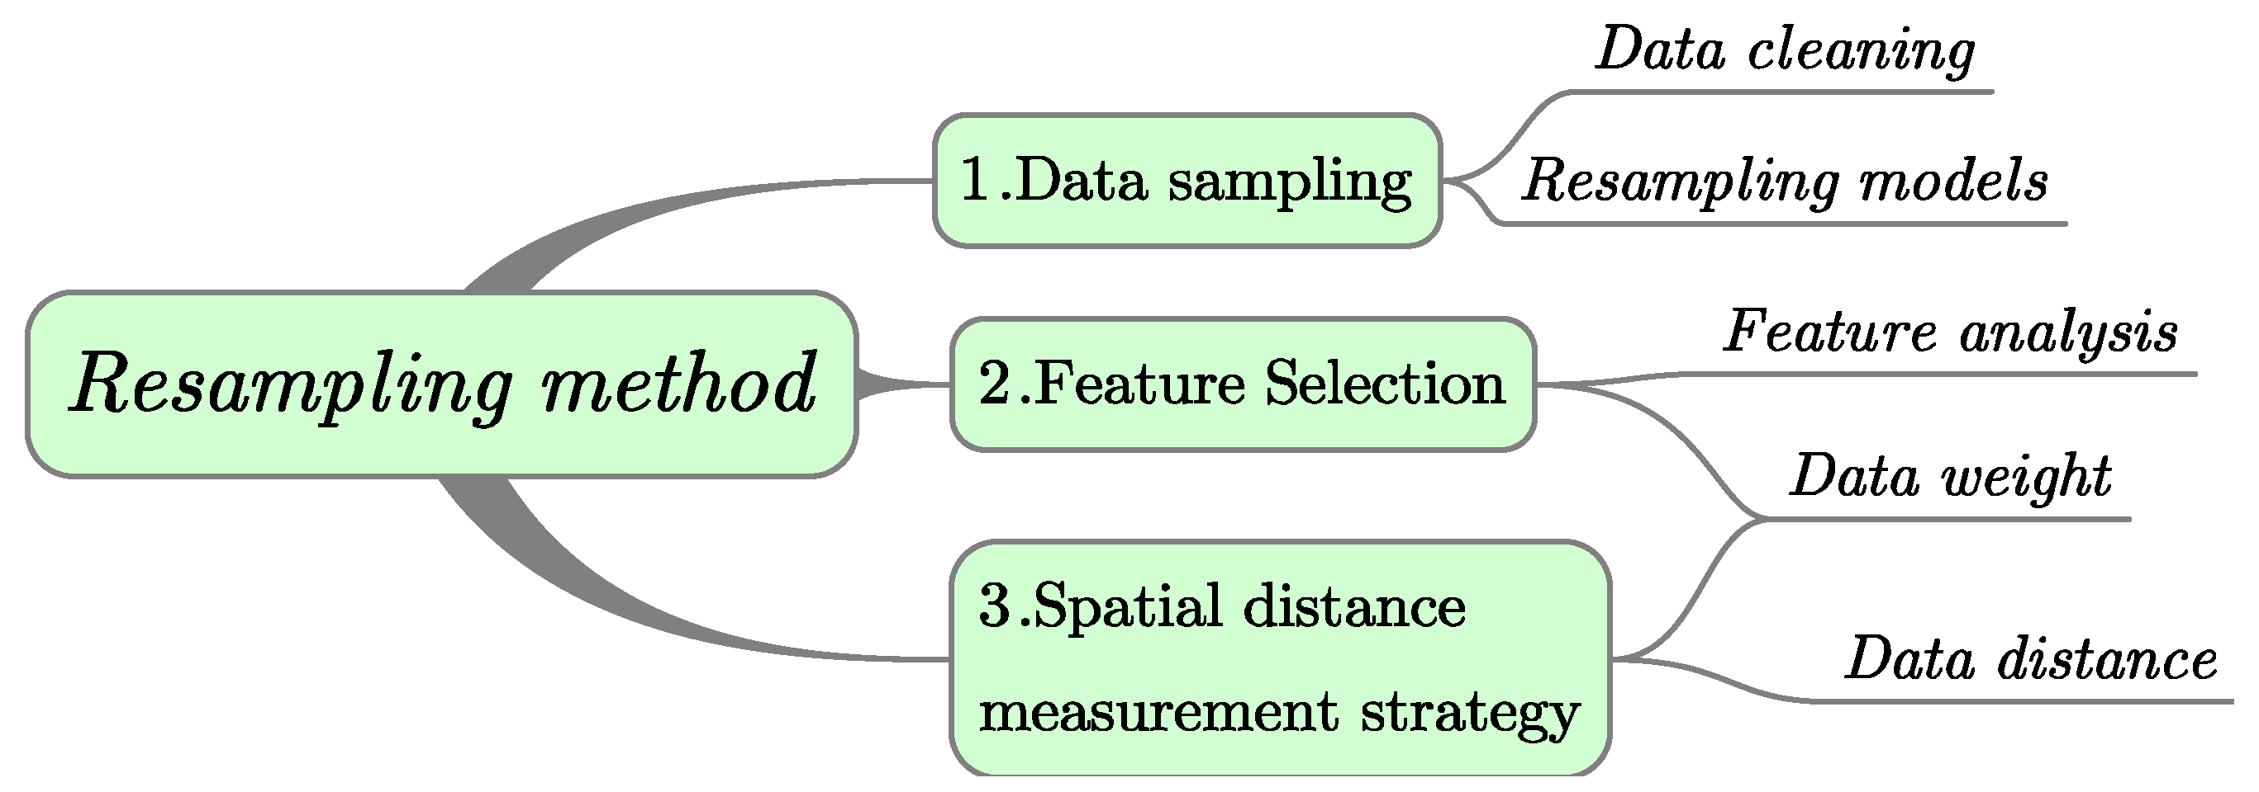
Resampling – Changing the Lens
Downsampling: Aggregating high-frequency data into lower frequency (e.g., Daily → Monthly) to find the "Big Picture".
Upsampling: Increasing frequency (e.g., Quarterly → Monthly) and "filling in" the gaps using interpolation.
The Purpose: Removing daily "noise" to reveal underlying quarterly or annual trends.

Slide 3
Lag Analysis – The Memory of Data
The Concept: Using past values to explain current ones.
Mechanical Necessity: Many regional phenomena have a delay. For example, heavy rain in March (Lag) affects the crop yield in June.
Autocorrelation: Measuring how a variable is correlated with a delayed version of itself.

Slide 4
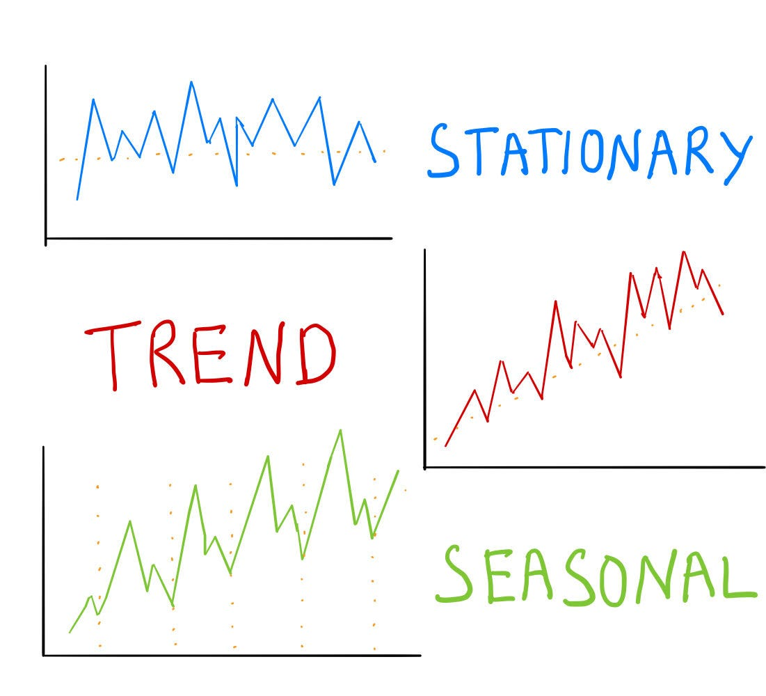
Stationarity vs. Trends
Trends: A long-term increase or decrease in the data.
Stationarity: A property where the mean and variance do not change over time. Most statistical models require data to be "Stationary" to make valid predictions.
Detrending: The process of removing a trend (e.g., through "Differencing") to make the data stationary.

